Slide 1
SECM Assignment 2: Meeting Scheduler System – Proposed GUI & Design Patterns
Joe K (b9026253), Ahnaf A (b8043405), Karolina M (b8024909)

Slide 2
A. Introduction
Throughout this presentation we will introduce our design for the Graphical User Interface of the meeting scheduler system outlined in the assignment brief, along with storyboards showing usage of the interface and what design patterns we have used.

Slide 3
B. Design of Graphical User Interface (GUI)
In this section we will present our design of the GUI for the Meeting Scheduler system, and talk about what HCI guidelines and patterns have been used.

Slide 4
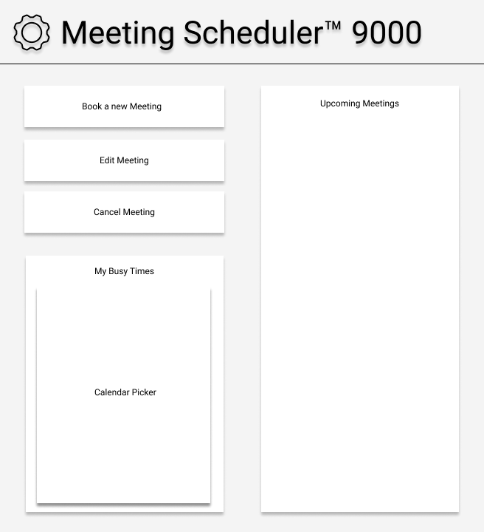
GUI: Homepage / Main Page
The home page has been split into two distinct sections, each with its own purpose.
On the left-hand side, there are three buttons used to edit new and existing meetings.
Below that, there is a calendar picker outlining the unavailable times of the current participant.
These times show the periods in which the participant cannot attend a meeting.
On the right-hand side, there is a ListBox that will show any meetings scheduled in the future for the current participant.

Slide 5
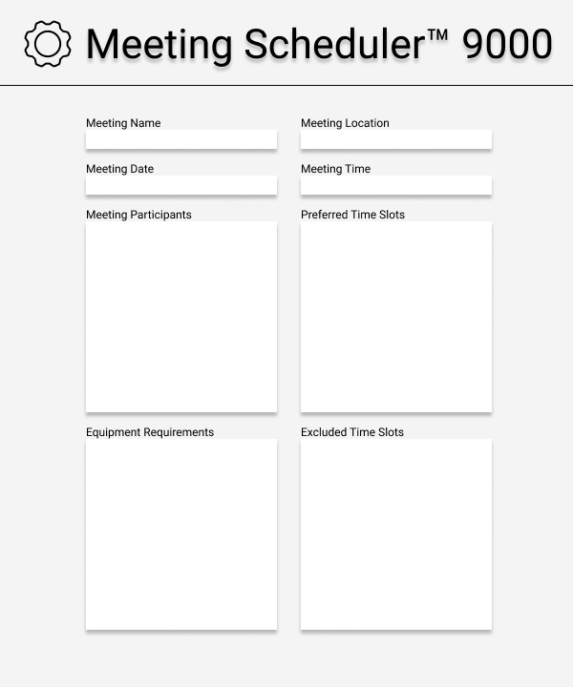
Meeting Details (Book / Edit Meeting)
In this page, there are four quadrants with different types of information.
At the very top of the page, the relevant meeting details are plastered.
Right below it, lists of participants, preferred and excluded times as well as equipment requirements.

Slide 6
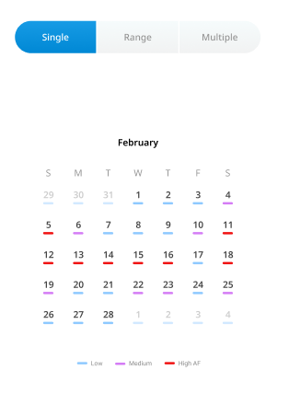
Calendar Date Picker Pop-Up
The following component is a calendar picker.
This allows the current user to pick suitable meetings dates from a bird’s eye view
The different colour coded underlines help distinguish between days with existing meetings and days with no events

Slide 7
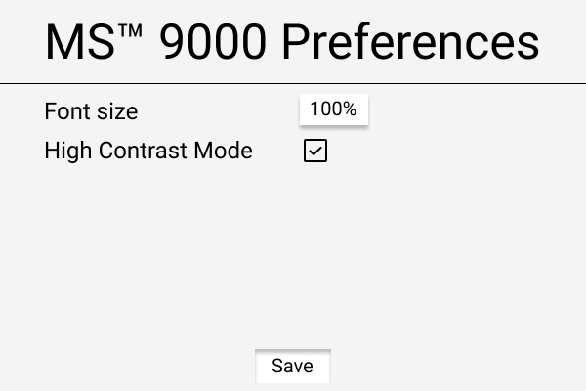
Preferences (Accessibility Settings)
The application has certain preferences that can be adjusted by the user.
The first option is “Font Size” which allows the user to alter the text size
The second option is “High Contrast Mode”. This enables the application to change it’s colour scheme to suit users with visual impairment

Slide 8
C. Storyboards
In this section, we will show two example storyboards describing some aspects of the use of our proposed GUI design.

Slide 9
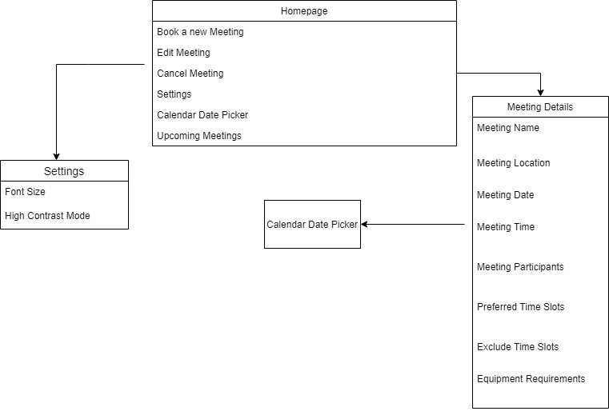
Meeting Scheduler System
The overall view on the Meeting Scheduler System.
The system has 4 pages – Homepage, Settings Page, Meeting Details Page and Calendar Date Picker.

Slide 10
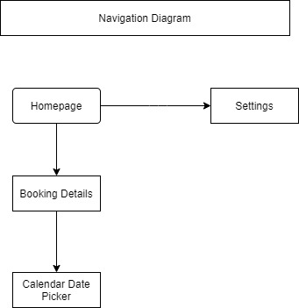
Navigational Structure Diagram
Navigation Model for meeting scheduler system, displaying how the user can access different parts of the system.
The system homepage can take the user to the settings page or the booking details page which opens a calendar date picker.

Slide 11
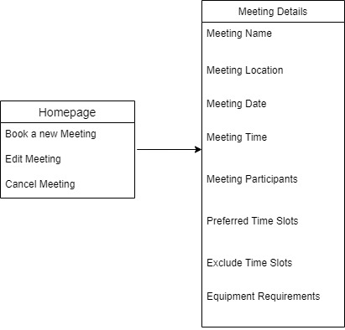
Homepage To Meeting Details
Three different buttons from the homepage – Book a new Meeting, Edit Meeting and Cancel Meeting – take the user to the meeting details page.
On the meeting details page, the user can view and edit different properties such as name, time and location preferences.

Slide 12
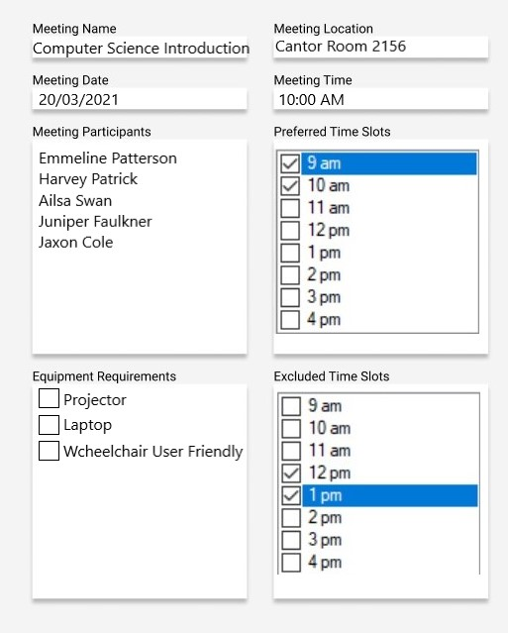
Creating A Meeting
An example of creating a new meeting on the meeting details page which can be done after clicking the book a meeting button.
The system allows the user to type information such as meeting name as well as gives the user options to choose the meeting location, date, time, preffered and exluded time slots and equipment requirements.
The meeting scheduler system also automatically adds the user to the participants list.

Slide 13
D. Design Patterns
In this section, we will explore the software design patterns we have chosen to aid in the creation of the program.

Slide 14
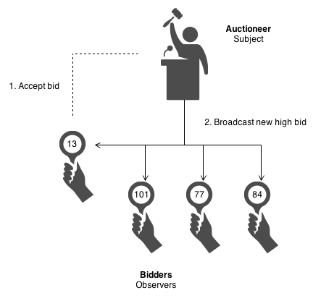
Software Design Patterns: Observer
The observer design pattern defines a one-to-many dependency between objects so that when one object changes state, all its dependents are notified and updated automatically.
On the right is an example of an observer pattern in real life, where bidders observe the price of an auction and react accordingly.
This pattern can be applied to the meeting scheduler system to notify meeting participants via the Participant class whenever a new meeting is created or an existing meeting is updated.

Slide 15
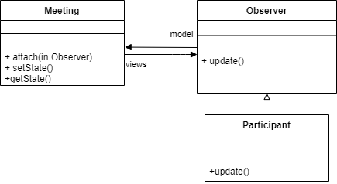
Observer Class Diagram
Shown left is a class diagram outlining an implementation of the observer design pattern in the context of the meeting scheduler system.
In this context, the Participant class will observe the Meeting class and wait for any new meetings or updates to existing ones. Where applicable, the Participant class can then call on other code to notify the relevant user.

Slide 16
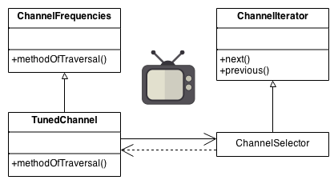
Software Design Patterns: Iterator
The iterator design pattern provides a way to access the elements of an aggregate object sequentially without exposing its underlying representation.
On the right is an example of the iterator pattern in the real world, where a user can iterate through TV channels.
This will be used in the meeting scheduler system to securely and neatly iterate over meetings, locations, and participants.

Slide 17
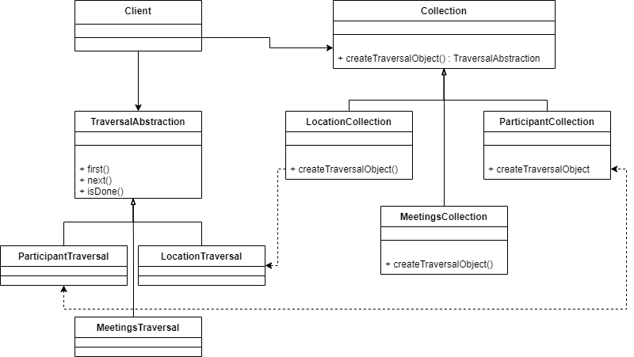
Iterator Class Diagram
Shown left is a class diagram outlining an implementation of the iterator design pattern in the context of the meeting scheduler system.
The lists being iterated over in this context are the available locations, existing meetings, and participants within those meetings.

Slide 18
E. Conclusions & Summary
From what you’ve seen so far, you can observe that we’ve selected a GUI components including calendar picker, font size and high contrast text.
From the storyboard section, we visually explained the paths taken for the participant to be able to create and/or edit meetings.
In the final section, we demonstrated the use cases of two design patterns namely the observer and iterator class. This was complemented by individual class diagrams.

Slide 19
Peer Marking
# | Team Members | Contribution
1 | Joe Kirkup | 33.33%
2 | Ahnaf Ahmed | 33.33%
3 | Karolina Mroz | 33.33%

Slide 20
References
Material.io, n.d. Material.io. [Online] Available at: https://material.io/ [Accessed 9 February 2021].
Phosphor Icon, n.d. Phosphor Icon. [Online] Available at: https://phosphoricons.com/ [Accessed 9 February 2021].
Sourcemaking.com, n.d. Design Patterns - Iterator. [Online] Available at: https://sourcemaking.com/design_patterns/iterator [Accessed 13 March 2021].
UI Patterns, n.d. Adaptable View. [Online] Available at: http://ui-patterns.com/patterns/AdaptableView [Accessed 9 February 2021].
UI-Patterns, n.d. Calendar Picker. [Online] Available at: http://ui-patterns.com/patterns/CalendarPicker [Accessed 9 February 2021].
Design Patterns, n.d. Observer. [Online] Available at: https://sourcemaking.com/design_patterns/observer [Accessed 17th March 2021]

